Slide 1

Comparative Analysis of Deep Learning Models for ADHD Diagnosis using EEG
A Review of EEG-Transformer, LSTM, and Hybrid CNN-LSTM Approaches

Slide 2

The Challenge of ADHD Diagnosis
Current Problem: Subjective Diagnosis
The Need for Objective Methods
Traditional ADHD diagnosis heavily relies on subjective assessments such as the DSM-5 Questionnaire, clinical interviews, and behavioral observations. These methods are inherently time-consuming, dependent on trained specialists, and prone to inconsistencies, often leading to delayed diagnoses and misdiagnosis. This subjectivity poses a significant barrier to effective early intervention.
The limitations of current diagnostic practices underscore a critical need for objective and automated methods. Research is increasingly focused on leveraging quantifiable biological markers, such as Electroencephalogram (EEG) brain signals, combined with advanced deep learning techniques, to provide a more accurate, efficient, and objective diagnostic pathway for ADHD.

Slide 3
Paper 1: EEG-Transformer Model
Problem Addressed
Relevance
The paper addresses the subjectivity and inefficiencies of current ADHD diagnostic methods (DSM-5, clinical interviews) by proposing an objective, automated approach using EEG signals and deep learning, specifically a Transformer model.
ADHD is a prevalent neurodevelopmental disorder impacting attention, memory, and learning, with significant global prevalence and persistence into adulthood. Early and objective diagnosis is crucial for timely intervention and improved outcomes.
Methodology & Key Results
Dataset
Public dataset from Technical University of Dresden, Germany. Comprises 144 children (48 ADHD, 52 ADD, 44 Healthy Controls) with 56 EEG channels, 256 Hz sampling rate, and 1.5s trial length. Preprocessed using Independent Component Analysis (ICA).
Proposed an EEG-Transformer model utilizing an attention mechanism to learn relationships across all EEG channels simultaneously. Achieved an accuracy of 95.85% and an AUC of 0.9926, outperforming traditional CNN-based models.

Slide 4
Paper 2: EEG-based LSTM Networks
Problem Addressed
Relevance
The study aims to address the subjectivity of current ADHD diagnostic approaches (DSM-5, behavioral observations) by investigating whether EEG-based Long Short-Term Memory (LSTM) networks can objectively discriminate between ADHD and neurotypical children.
ADHD is a pervasive disorder with a 5-7% prevalence. Current biomarkers like the theta/beta ratio are controversial. Objective, EEG-based tools are essential for improving diagnostic accuracy and facilitating timely interventions.
Dataset
Methodology & Key Results
Involved 60 children (30 ADHD, 30 Neurotypical) undergoing Continuous Performance Tests (CPT). EEG data segments included resting state, cognitive execution, and a fusion of both, recorded via a portable wireless device.
Proposed Solution:
Use EEG brain signals as objective biomarkers.
Apply LSTM networks to learn temporal brain activity patterns.
Automatically classify ADHD and neurotypical children.

Slide 5
Paper 3: Hybrid CNN-LSTM Model
Problem & Rationale
Dual Datasets
Addresses the questionable reliability of traditional diagnostic tools. The authors argue that CNNs alone miss temporal dynamics, while LSTMs miss spatial patterns. A hybrid approach is proposed to capture both simultaneously.
ADHD Dataset: 121 subjects (61 ADHD, 60 Control), ages 7-12, diagnosed via DSM-IV.
FOCUS Dataset: 9 subjects playing an EMOTIV-based mental instruction game, providing 57,000 samples.
Hybrid Methodology
Proposed Solution
Use EEG brain signals as objective biomarkers for ADHD diagnosis.
Apply CNN layers to automatically learn spatial relationships between different EEG channels and brain regions.
Apply LSTM layers to learn temporal brain activity patterns and attention-state changes over time.
Combine spatial and temporal EEG features into a unified representation.
Automatically classify subjects as ADHD or Healthy Controls using a deep learning model.

Slide 6

Comparative Analysis: Methodologies
EEG-Transformer
EEG-based LSTM
Hybrid CNN-LSTM
Attention Mechanism
Sequential Memory
Spatiotemporal Fusion
Utilizes self-attention to learn complex relationships between all EEG channels simultaneously.
Leverages internal memory cells to process sequential data and learn cognitive state transitions.
Combines CNN for spatial feature extraction with LSTM for long-term temporal dependencies.
Captures global spatial-temporal patterns
Excels at temporal dependency learning
Simultaneous spatial & temporal learning
Overcomes CNN/LSTM local limitations
Models dynamic neurological state changes
Automatic hierarchical feature extraction
High-performance global feature extraction
Effective for high-resolution time-series
Robust against non-stationary EEG noise

Slide 7

Comparative Analysis: Datasets
Paper 1: EEG-Transformer
Paper 2: LSTM Networks
Metric
Paper 3: Hybrid CNN-LSTM
Source
Tech. Univ. of Dresden (Germany)
Clinical CPT Tests
IEEE Data Port (ADHD & FOCUS)
Total Subjects
144 Children
60 Children
121 (ADHD) / 9 (FOCUS)
Groups
48 ADHD, 52 ADD, 44 Healthy
30 ADHD, 30 Neurotypical
61 ADHD, 60 Healthy (ADHD Set)
EEG Channels
56 Channels
Portable Wireless Device
19 Channels (ADHD) / 14 (FOCUS)
Preprocessing
ICA for noise removal
Standard clinical processing
ICA (90% threshold), FIR Filtering

Slide 8
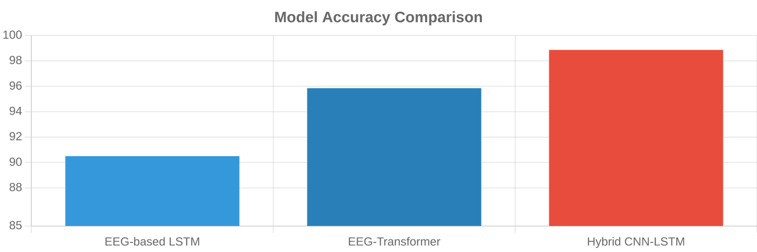
Comparative Analysis: Performance Metrics
Model Architecture
Primary Dataset
Accuracy (%)
AUC / Other Metrics
EEG-Transformer
Dresden (144 subjects)
95.85%
0.9926 AUC
EEG-based LSTM
CPT Task (60 subjects)
90.50%
± 0.81% Std Dev
Hybrid CNN-LSTM
IEEE ADHD (121 subjects)
98.86%
98.28% (FOCUS Dataset)

Slide 9




Common Future Directions
Explainable AI (XAI)
Multi-modal Integration
Implementing techniques like SHAP, Grad-CAM, or LIME to identify critical EEG channels and temporal patterns. This enhances clinical interpretability and builds trust in AI-driven diagnostic decisions.
Combining EEG data with eye-tracking, fMRI, or behavioral performance metrics (CPT). Multi-modal fusion can lead to more robust models and a deeper understanding of neurodevelopmental markers.
Severity Prediction
Real-time Detection
Optimizing models for low-latency deployment on portable or wearable EEG devices. This enables immediate feedback for clinical interventions and adaptive learning environments in schools.
Transitioning from binary classification to predicting ADHD severity levels (Mild, Moderate, Severe). This provides clinicians with a more nuanced tool for personalized treatment planning.

Slide 10





Key Takeaways and Future Outlook
Key Takeaways
Future Outlook
Superior Accuracy: Deep learning models (Transformer, LSTM, Hybrid) consistently achieve 90-99% accuracy, far exceeding traditional clinical methods.
Clinical Integration: Moving from research to clinical tools requires Explainable AI (XAI) to provide interpretable diagnostic evidence for physicians.
Objective Biomarkers: EEG signals provide quantifiable neurological markers, reducing the subjectivity inherent in behavioral assessments.
Wearable Monitoring: Adapting these models for portable EEG devices could enable continuous, real-world assessment in schools and homes.
Architectural Evolution: The shift from CNNs to Transformers and Hybrid models allows for better capture of global spatiotemporal brain dynamics.
Severity Prediction: Future research will likely focus on predicting ADHD severity levels rather than simple binary classification.

Slide 11

Subjective Clinical Assessment Creates Critical Gaps in Schizophrenia Diagnosis
Schizophrenia is a complex chronic brain disorder affecting millions globally. A major diagnostic challenge is the reliance on traditional visual assessment of EEG signals, which is time-consuming and inherently subjective, leading to inconsistent clinical outcomes.
Chronic
Subjective
Objective
Brain Disorder
Visual Assessment
Clinical Need
Characterized by cognitive deficits, hallucinations, and delusions.
Traditional EEG interpretation is time-consuming and expertise-dependent.
Early and accurate diagnosis is essential for effective management.
Notes:
Schizophrenia diagnosis faces significant hurdles because current methods are too subjective. We're talking about a chronic brain disorder that affects millions, yet its diagnosis often relies on traditional, visual EEG assessments. This approach is time-consuming and prone to inconsistencies, leading to delays and misdiagnoses. We need objective, accurate tools to ensure timely and effective management for patients. This is where advanced EEG analysis comes in, offering a path to more reliable diagnostics.

Slide 12

Mutation-Boosted Optimization and Hybrid Deep Learning Enhance EEG Analysis
MAO Preprocessing Optimization
MULTICHANNEL EEG DATA
Mutation-boosted Archimedes Optimization dynamically adjusts parameters to enhance signal quality and reduce noise.
MAO PREPROCESSING
Hybrid CNN-LSTM Architecture
Extracts complex spatial features via CNN and captures long-term temporal dependencies using LSTM networks.
CNN (SPATIAL PATTERNS)
Entropy-Related Feature Fusion
LSTM (TEMPORAL PATTERNS)
Integrates spectral and permutation entropy to capture intricate EEG complexity for robust classification.
ENTROPY FEATURE INTEGRATION
SCHIZOPHRENIA DETECTION
Notes:
Building on the need for objective diagnostics, we developed a novel approach using Mutation-boosted Optimization and Hybrid Deep Learning. Our MAO preprocessing dynamically refines EEG signals, significantly improving quality and reducing noise. Then, a hybrid CNN-LSTM architecture extracts both spatial and temporal patterns from the data. We also integrate entropy-related features, capturing the intricate complexity of EEG for robust classification. This comprehensive pipeline moves us closer to a more precise diagnostic tool, as you'll see in our performance results.

Slide 13

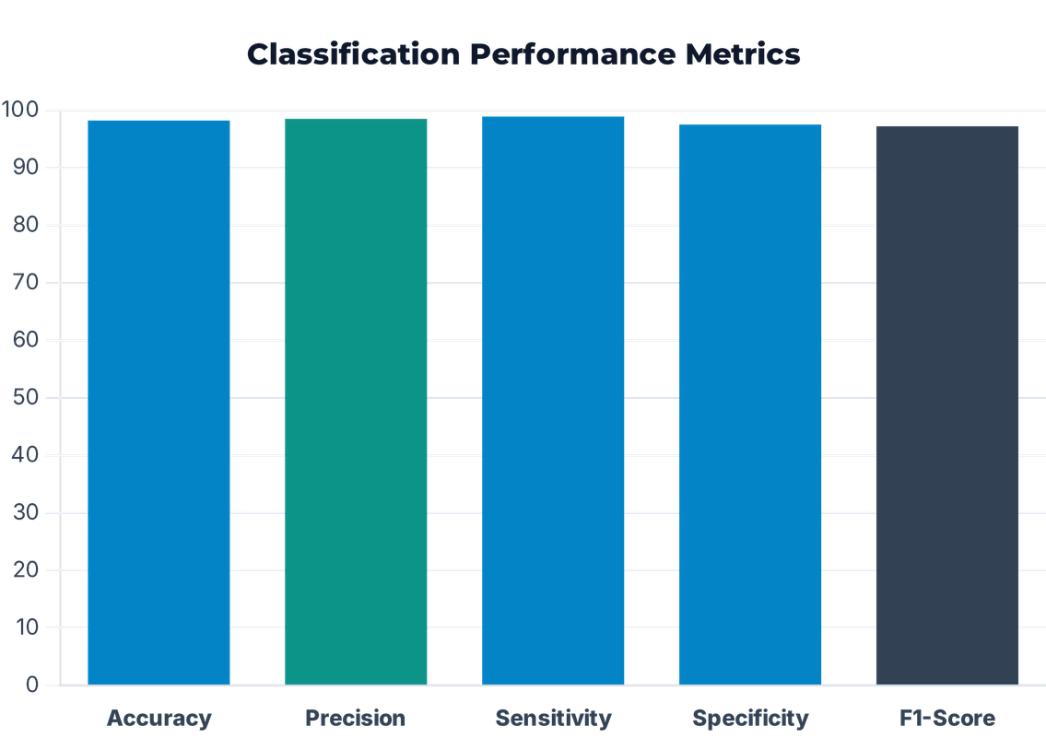
MAO-CNN-LSTM Pipeline Achieves State-of-the-Art Diagnostic Performance
The proposed approach surpasses existing techniques, achieving an exceptional accuracy of 98.2% and precision of 98.5%.
Improved Signal Quality
The MAO algorithm significantly enhances Signal-to-Noise Ratio (SNR) and reduces artifact rejection rates, ensuring reliable data for clinical analysis.
Notes:
So, how well does this advanced architecture perform? Our MAO-CNN-LSTM pipeline achieves state-of-the-art diagnostic performance, with an exceptional accuracy of 98.2% and precision of 98.5%. This isn't just a marginal improvement; it's a significant leap forward. The MAO algorithm's ability to enhance the Signal-to-Noise Ratio and reduce artifacts is crucial here, ensuring the data we analyze is reliable. These results demonstrate the pipeline's potential for real clinical impact. Now, let's look at how students can further advance this critical research.

Slide 14

Strategic Research Enhancements for Students in Neuro-Mental Health AI
Students can build upon this research by focusing on several key enhancement areas to transition the model from a research tool to a clinical standard.
Research Area
Potential Enhancement for Students
Real-time Systems
Optimize the MAO-CNN-LSTM pipeline for real-time processing on portable EEG or mobile devices.
Explainable AI (XAI)
Apply XAI techniques to interpret the features learned by the CNN-LSTM, identifying specific EEG biomarkers.
Multimodal Fusion
Integrate EEG with other neuroimaging modalities (fMRI, MRI) or genetic data for a more robust diagnostic profile.
Longitudinal Studies
Extend the research to track disease progression or predict treatment response in schizophrenia patients.
Novel Architectures
Explore advanced transformer-based models for finer-grained spatiotemporal feature extraction from EEG.
Notes:
Looking ahead, students have a clear path to build on this foundational work and transition our model into a clinical standard. They can focus on optimizing the pipeline for real-time processing, making it suitable for portable devices. Another key area is Explainable AI, where visualizing attention weights can identify specific brain regions linked to schizophrenia. We also see great potential in multimodal fusion, integrating EEG with other neuroimaging or genetic data for a more robust diagnostic profile. These strategic enhancements will accelerate the model's journey from research to practical application.

Slide 15

References
PAPER 1
Classification of Attention Deficit/Hyperactivity Disorder Based on EEG Signals Using an EEG-Transformer Model
He, Y., Wang, X., Yang, Z., et al. (2023). Journal of Neural Engineering, 20(5), 056013. DOI: 10.1088/1741-2552/acf7f5
PAPER 2
Neurological state changes indicative of ADHD in children learned via EEG-based LSTM networks
Chang, Y., Stevenson, C., Chen, I. C., et al. (2022). Journal of Neural Engineering, 19(1), 016021. DOI: 10.1088/1741-2552/ac4f07
PAPER 3
The Hybrid Deep Learning Model for Identification of Attention-Deficit/Hyperactivity Disorder Using EEG
Chugh, N., Aggarwal, S., & Balyan, A. (2024). Clinical EEG and Neuroscience, 55(1), 22–33. DOI: 10.1177/15500594231193511

Slide 16
DSM stands for:
Diagnostic and Statistical Manual of Mental Disorders
It is the official handbook used by psychiatrists and psychologists worldwide to diagnose mental and behavioral disorders.
Why is DSM Important?
When a child is suspected of having ADHD, doctors do not immediately use EEG or MRI.
Instead, they follow DSM-5 criteria.
Example:
ADHD Symptoms
Inattention
Cannot focus
Makes careless mistakes
Easily distracted
Forgets things
Impulsivity
Interrupts others
Acts without thinking
Cannot wait turn

Slide 17
If enough symptoms are present for:
At least 6 months
and they affect:
School
Home
Social Life
the child may be diagnosed with ADHD.

Slide 18
Why Do These Papers Criticize DSM?
All three ADHD papers mention the same problem:
DSM-Based Diagnosis is Subjective
Because diagnosis depends on:
Doctor's Judgment
Parent Feedback
Teacher Feedback
Behavioral Observation
Two doctors may not always agree.
Parents may describe symptoms differently.
Teachers may observe different behaviors.
This can lead to:
Delayed Diagnosis
Misdiagnosis
Late Treatment

Slide 19
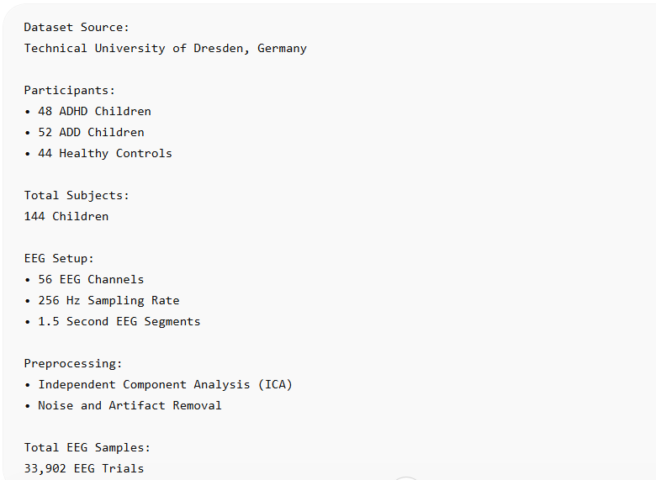

Slide 20
Spatial Features(Which brain regions activate together?
Spatial features represent relationships between different EEG channels or brain regions at the same point in time.
Temporal Features (How brain activity changes over time?
Temporal features represent how EEG signals evolve and change over time, capturing dynamic brain activity patterns.
CNN
Learns spatial relationships among EEG channels.
LSTM
Learns temporal dependencies and brain-state transitions over time.
CNN-LSTM
Combines spatial and temporal learning to capture both where and how brain activity changes.

